Slide 1
Managing Change
Tracy Owens-Ammons
HRMT655-1902A-01
Managing Organizational Development and Change
Unit 3 IP – Professor Hardwick
April 29, 2019

Slide 2
Organizational Reorganization
Its restructuring firms operations and resources so as to drive change in the organization
Exploring the modules of needs assessment to see how each work together.
It involves considering the tools and theories used to implement needs assessment, and pinpointing the validity levels of the Instructional System.
Its important to detect the advantages and disadvantages that may come with reorganization
It comes along with resistant to change
Notes:
The reorganization involves a change in the normal operations of the organization to drive a positive change. It starts with assessing the needs for change and what needs to be changed.
The reorganization comes along with the advantages and disadvantages; hence there is a need to do a cost-benefit analysis to see how worth the change is.
For reorganization, leaders must be ready to deal with resistant to change as well as negative reactions from employees and other stakeholders.

Slide 3

How to deal with resistant and negative reactions to change in Pegasus
Ensure the change is implemented at the right time.
Creating awareness on need for change, and expectations (Brand & Wilson, 2000).
Show passion for the change.
Remain positive and supportive through the entire change process.
Notes:
The change should not be an overnight thing, but every employee should be aware of the change.
There is a need to inform the employees why reconstruction is essential and the benefits it will create to the organization, as well as how they will benefit at a personal level (Cooper, 2015).
The change affects people differently; hence leaders should remain positive and supportive to the employees throughout the entire process
Perfect timing for increases the outcomes.

Slide 4
Driving communication in Pegasus
Set communication standards-set accepted practices and procedures of communication for different teams within the organization.
Encourage feedback and participative communication at all levels of the organization and especially between different groups
Show the importance of listening, respect, helping and empathy in the communication.
Create room for technology in the communication.
Notes:
To facilitate communication between different skill groups, there is a need to create standards for communication. However, the practices and procedures for communication should not be so stringent that they don’t allow people to express themselves (Brand & Wilson, 2000).Communication needs to be participative, and feedback should be encouraged. The opinion of different teams and employees should not be disregarded.
There is a need for ‘open door policy’ that makes all employees comfortable and free to communicate to management and across all teams. All teams and individuals should have their opinions respected.
Creating room for technology to foster communication is essential . e.g hipchats, google hangouts and slack can be effective tools (Elving, 2005).

Slide 5
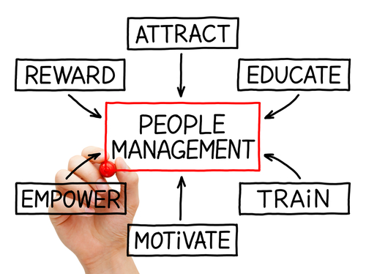
Leadership skills development for Management and executive
Ability to keep a positive altitude at all conditions
Creating a visionary leadership among the Pegasus managers and executives
Cooperation among leaders-leaders of different teams should be ready to work together (Elving, 2005).
Focus-leaders should have clear focus on their goals
Ability to empower and inspire employees-creating moral in the team and organization
Notes:
Pegasus leaders should have the ability to remain positive in all situations, and any challenges should be faced from a positive perspective.
Leaders should have goals that they are working to achieve, in the long run, and short-run, and should be integrated into the overall organization’s goals (Cooper, 2015).Leaders of different teams and levels should be ready to work together. The top management should respect and cooperate with line management.

Slide 6
Strategies to create a synergy in Pegasus
For Pegasus to remain competitive, create work motivation and employee retention, there is need for team work and collaborations.
This can be created through:
Create a shared vision, values and goals
Effective leadership and followership
Positive environment
Effective communication
Encourage trust, respect and compassion in the organization
Notes:
Should be a positive relationship between leaders and followers. Synergy is a positive process and must be managed.
A positive teamwork culture is therefore paramount (Brand & Wilson, 2000).Every member should feel appreciated. Any conflicts should be settled positively.
Effective communication between and within teams as well as individuals should be created and maintained.
Trust, Respect, and compassion should be highly valued in the organization.

Slide 7
References
Cooper, R. (2015). Information, communication and organization: a post-structural revision. In For Robert Cooper(pp. 124-148). Routledge
Elving, W. J. (2005). The role of communication in organizational change. Corporate communications: an international journal, 10(2), 129-138.
Brand, H. E., & Wilson, J. (2000). The impact of organizational restructuring on organization climate and employee attitudes. South African Journal of Economic and Management Sciences, 3(1), 97-108.

